Slide 1




The National Overdose Crisis and Substance Use in Adolescents
shadland@mgh.harvard.edu
@DrScottHadland
@drscotthadland
scotthadland
Scott Hadland, MD, MPH, MS
Chief, Adolescent & Young Adult Medicine
Associate Professor of Pediatrics
Mass General for Children
Harvard Medical School
Boston, MA

Slide 2

“Receiving addiction treatment in a primary care setting meant that I not only was able to access recovery but also build a foundation for a healthy life. Coming into treatment, I had a multitude of medical needs that had been left unmet while I was in active addiction—from vaccines to chronic medical conditions to gender-affirming care. Together, my physician and I were able to address all of this in a place where I felt supported and safe. I was seen as a whole person and because of that treatment not only saved my life, but helped me thrive in it, as well.”
- Eitan

Slide 3
Disclosures / Funding Source
Conflict of interest statement:
  I have no commercial relationships to disclose
  I will not be discussing any unapproved uses of pharmaceuticals or devices
Funding Sources:
  National Institute on Drug Abuse R01DA057566, K23DA045085, R01DA047975, R34DA052836,
  Patient-Centered Outcomes Research Institute EACB-26846, AU-2022C1-26455
  Presidential Leadership Scholars program

Slide 4

Children and adolescents have not been spared from the rise in morbidity and mortality attributable to opioids.
By the end of 50 minutes, learners will:
Describe the epidemiology of substance use-related harm in the US, with a focus on adolescents and young adults (“youth”)
Prescribe opioids in a manner that reduces the likelihood of risk for long-term opioid use and addiction
Ensure evidence-based screening and treatment for youth with substance use disorders

Slide 5
Part 1:
Epidemiology

Slide 6
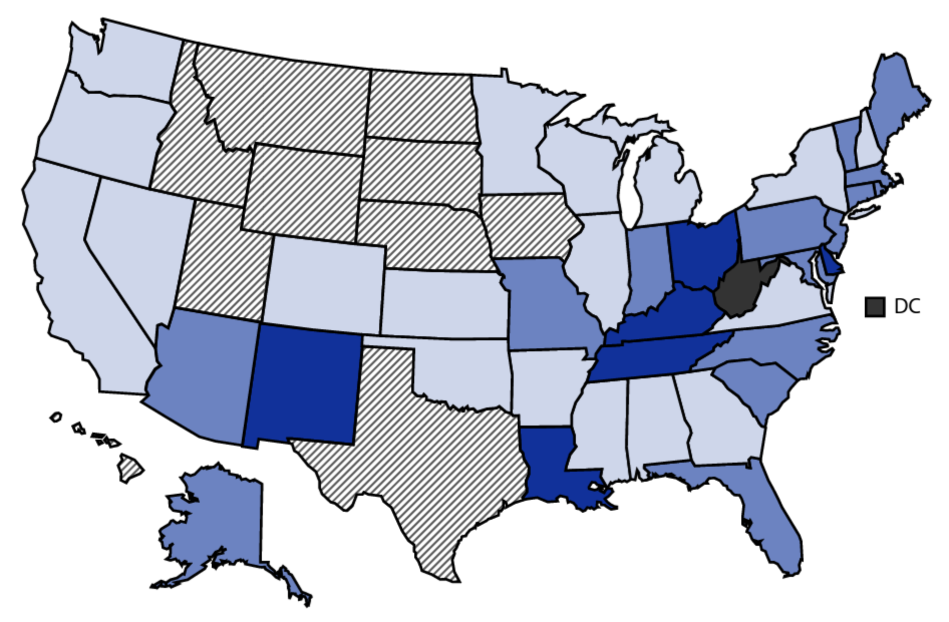
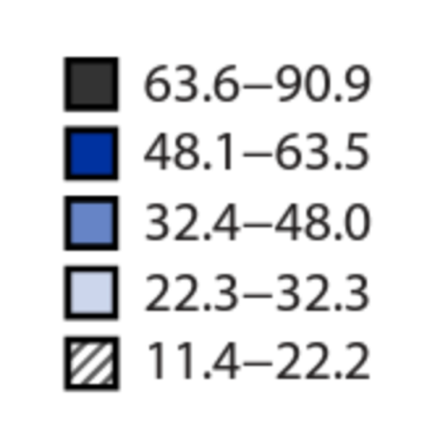
Drug Overdose Deaths, US 2021
Across the US:
1 death
every
5 minutes
2021 Data, NCHS, National Vital Statistics System, Mortality, 2023

Slide 7
Key Questions for Pediatricians
What is happening with youth overdose rates? Which opioids are involved?
What percentage of youth use opioids nonmedically?
When does opioid use rise to the level of a formal diagnosis of “addiction”?
What are the neurobiological underpinnings of addiction?

Slide 8
Overdose Deaths: Teens Aged 14-18
Fentanyl now ~75% of all overdose deaths in teens…
…However, most deaths involve an opioid PLUS another substance:
Cocaine
Benzodiazepines
Methamphetamine
Friedman J, et al. JAMA. 2022;327(14):1398-1400
Lim J, et al. JAMA Pediatr. 2021;175(2):194-196

Slide 9
Why Youth Matter in this Crisis
2 in 3 individuals in opioid treatment report first use before age 25, and 1 in 3 report first use before age 18
1 in 19 students
(About 1-2 students in a typical classroom)
*Note: Only 0.4% of all 12th grade students reported lifetime heroin use in 2020
2021 Data, Monitoring the Future, University of Michigan, 2022

Slide 10
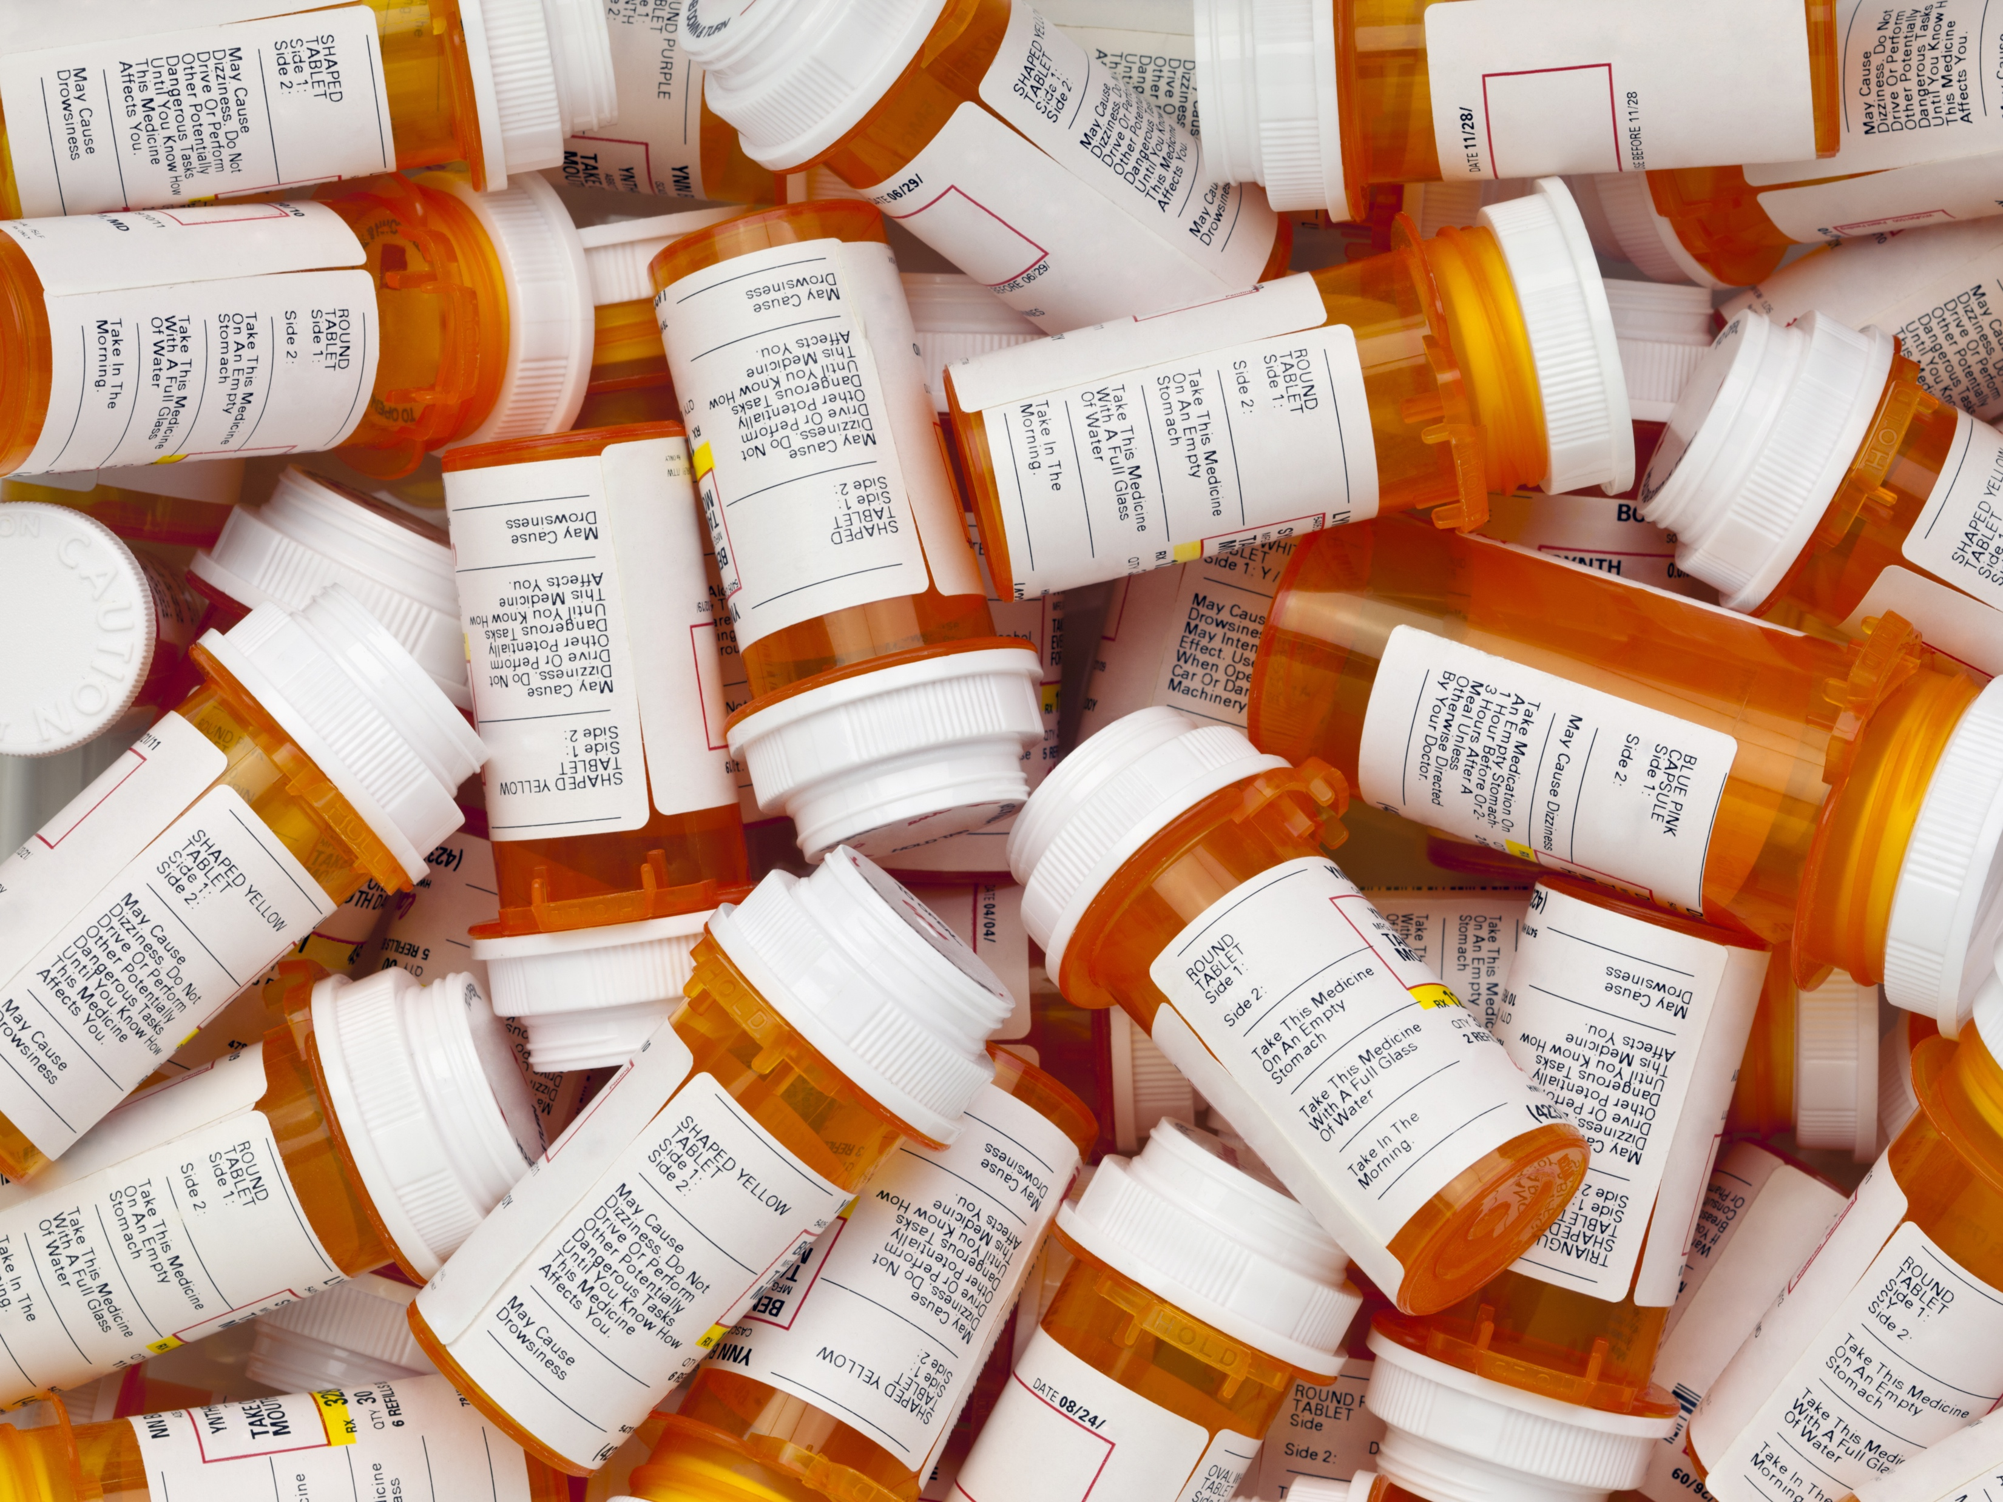
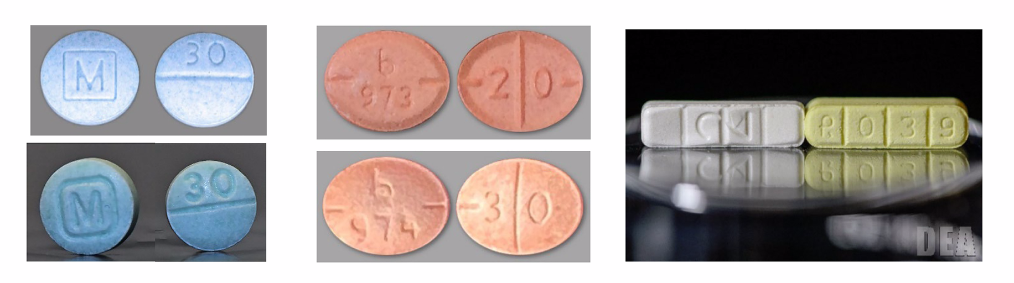
Counterfeit Pills:
US Drug Enforcement Administration Fact Sheet, 2021
Notes:
Oxycodone (fentanyl-contaminated), Adderall (methamphetamine-contaminated), Xanax (fentanyl-contaminated)

Slide 11
Overdose Deaths, 10- to 19-year-olds, 2021:
Most (60%) overdose deaths occurred at home
Two-thirds (67%) of the time, someone else was also home
60% of the time, teen was pulseless by the time EMS arrived
Naloxone given in fewer than 1 in 3 overdose deaths
US Centers for Disease Control and Prevention, 2021

Slide 12
“Addiction”: Opioid Use Disorder
Opioid use occurring over 12 months with ≥2 of:
Taken in larger amounts / over a longer period than intended
Persistent desire / unsuccessful efforts to cut down
Excess time spent in activities to obtain, use or recover from substance
Craving
Failure to fulfill major role obligations at work, school, or home
Continued use despite having persistent / recurrent social or interpersonal problems
Social, occupational, or recreational activities given up
Recurrent use in situations in which it is physically hazardous
Continued use despite knowledge of having a persistent or recurrent physical or psychological problem
Tolerance
Withdrawal
Mild:
2-3 criteria
Moderate:
4-5 symptoms
Severe:
≥6 symptoms
Diagnostic and Statistical Manual of Mental Disorders 5, APA, 2013.

Slide 13
Volkow ND et al. N Engl J Med, 2016; 374:363-371.

Slide 14
Part 2:
Prescribing Opioids Appropriately

Slide 15
The Pendulum Has Swung…
Pain is the 5th vital sign; we should always treat pain…
Opioid overdose crisis; we need to stop prescribing opioids…
We should still prescribe opioids, but be thoughtful.

Slide 16
Key Questions for Pediatricians
What do recent trends in pediatric opioid prescribing rates show?
What is the risk that, after an initial prescription for an opioid, an adolescent or young adult will experience an overdose or develop addiction?
Which youth are at risk of developing problems?
What are steps to take before prescribing an opioid? What steps should be taken when an opioid is being prescribed to minimize the risk?

Slide 17
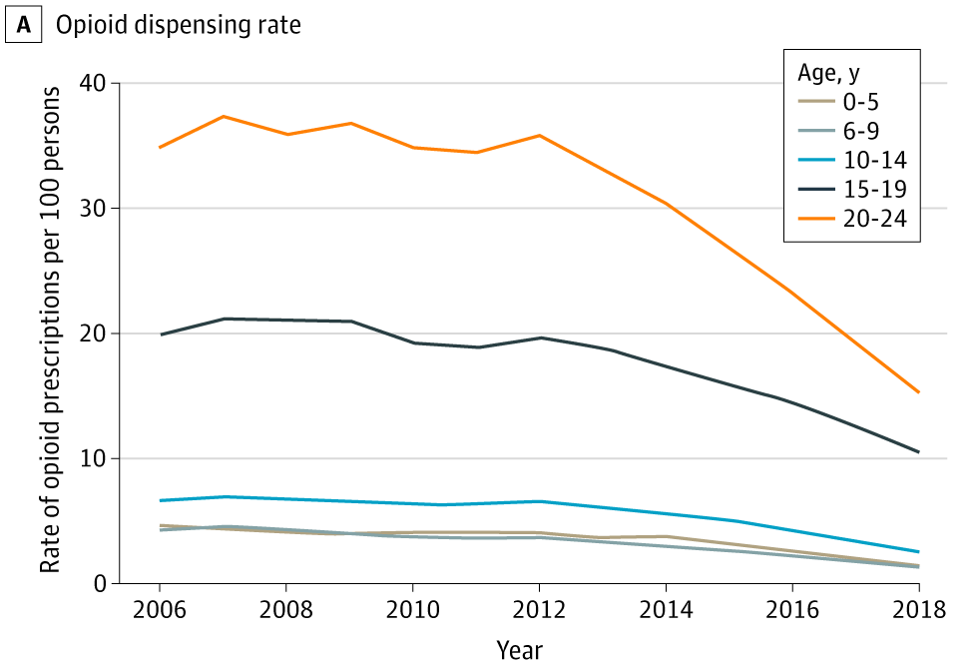
Opioid Dispensing Rates
Renny MH, et al. JAMA Pediatr. 2021;175(10):1043-1052

Slide 18

Prevalence of overdose or addiction during year after youth prescribed an opioid: ~1 in 300
Prescription-related risks
Long-acting opioid formulation
High daily opioid dose
Duration ≥7 days
Patient-level risks
Male sex
Older age
Family history of any addiction
Chronic pain
Mental health disorders (mood/anxiety, psychosis, ADHD, trauma)
Other substance use***
Chua KP, et al. JAMA Pediatr. 2020;174(2):141-148; Hadland SE, et al. Addiction, 2021;116(10):2790-2800

Slide 19
Best Practices
Before prescribing:
Maximize non-pharmacologic options (e.g., physical therapy, relaxation techniques) and non-opioid options (e.g., NSAIDs)
Conduct assessment of risk factors (e.g., other substance use disorder, mental health problems, family history)
Check state prescription drug monitoring program (PDMP)
When prescribing:
Use lowest effective dose of short-acting formulation (e.g., hydrocodone); do not use long-acting opioids for acute pain
Avoid co-prescribing of other sedatives (e.g., benzodiazepines)
Offer a short course (3 days or fewer typically sufficient)
Notify parents of minors; review safe storage
Massachusetts Department of Public Health, 2019

Slide 20
FDA Warnings/Contraindications
Children under 12 years:
Contraindication:
  Do not use codeine or tramadol
  Risk of serious breathing problems and death
Adolescents 12-18 years:
Contraindication:
  Do not use tramadol for post-operative pain management after removal of tonsils and/or adenoids
Warning:
  Do not use codeine or tramadol for pain management in patients with obesity, obstructive sleep apnea, or severe lung disease
US Food & Drug Administration, 2017

Slide 21
Part 3:
Screening and Treatment

Slide 22
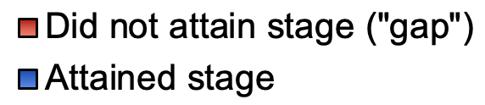
OUD Cascade of Care
Black youth, Hispanic youth:
65% & 74% less likely to receive treatment
32% & 58% less likely be be retained short-term
Barocas JA, et al. Am J Public Health. 2018;108(12):1675–1681
Hadland SE, et al. JAMA Pediatr. 2018;172(11):1029-1037
Wenren L, et al. AMERSA Annual Conference, 2021
Williams AR, Hadland SE, et al. Submitted, 2022

Slide 23
Key Questions for Pediatricians
What constitutes evidence-based treatment for youth with opioid use disorder?
How should pediatric providers screen for substance use?
Where can providers refer youth with problematic opioid use?
What are some additional simple things that every pediatric provider should do to address the US opioid overdose crisis?

Slide 24

Medications for Opioid Use Disorder:
Buprenorphine (≥16 yrs)
Methadone (≥18 yrs)
Naltrexone (≥18 yrs)
Evidence-based medications…
Treat withdrawal and cravings for opioids
Result in better retention in addiction care
Recommended by the AAP, other orgs
Typically offered alongside behavioral health services (though not required)
Waiver no longer needed to prescribe buprenorphine
Training available: https://pcssnow.org
Committee on Substance Use and Prevention. Pediatrics. 2016;138(3):e20161893

Slide 25
Available Medications
Buprenorphine | Methadone | Naltrexone
Partial opioid agonist | Full opioid agonist | Opioid antagonist
FDA-approved ≥16 yrs | Limited access <18 yrs | FDA-approved ≥18 yrs
Daily film or tablet Monthly injection Semi-annual implant | Daily dose | Daily tablet Monthly injection
Can be provided by primary care clinician (new policy!) | Only administered in person at qualified methadone center | Can be provided by primary care clinician

Slide 26
Rationale for Opioid Agonists
Heroin / fentanyl / short-acting pills
“High”
“High”
“ N O R M A L ”
Opioid levels / effect
Withdrawal, cravings
Adapted from: ASAM, Principles of Addiction Medicine, 2015

Slide 27
Rationale for Opioid Agonists
Buprenorphine / methadone
“High”
“ N O R M A L ”
Opioid levels / effect
Withdrawal, cravings
Adapted from: ASAM, Principles of Addiction Medicine, 2015

Slide 28
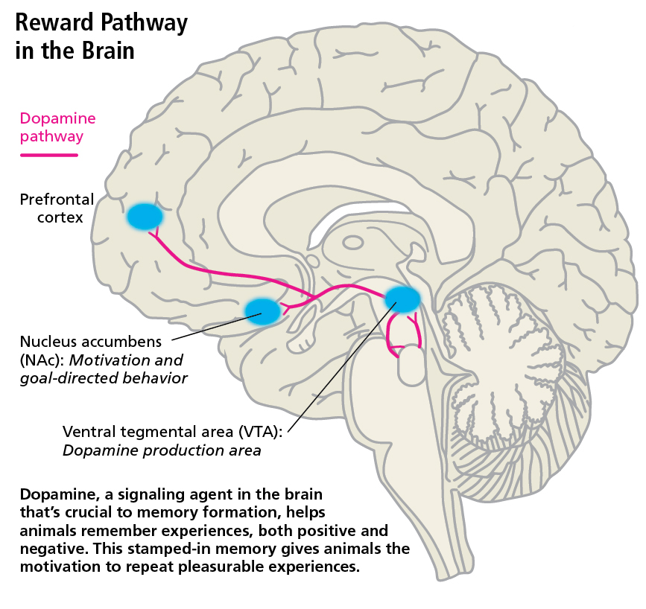
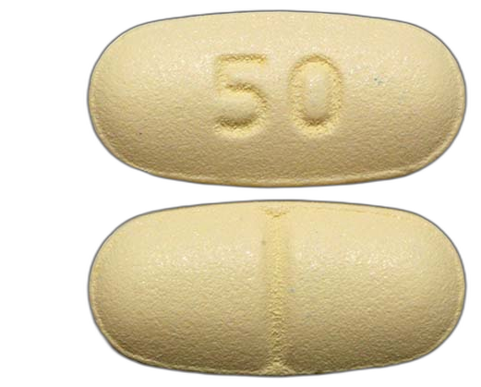
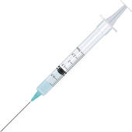
Rationale for Naltrexone
Naltrexone (antagonist):
Blocks the ‘high’ from taking opioids
May reduce cravings in some patients (similar mechanism to when used for alcohol use disorder)
Mu-opioid receptors are highly concentrated in the VTA and NAc.
Endogenous and exogenous opioids activate the reward pathway by binding in both regions.
Connor JP, et al. Lancet, 2015;387(10022):988-98.

Slide 29

What We All Can Do:
1
Screen for substance use and refer for treatment
2
Discuss overdose prevention and harm reduction
3
Change the language of addiction to reduce stigma

Slide 30
Screening to Brief Intervention (S2BI)
In the past year, how many times have you used:
Tobacco?
Alcohol?
Cannabis?
(Answers: “Never”, “Once or twice”, “Monthly”, or “At least weekly”)
…Stop if all are “never.” If any substance use, ask about other drugs.
Available for free at: https://www.drugabuse.gov/ast/s2bi/
Levy S, et al. JAMA Pediatr. 2014;168(9):822-8

Slide 31
Frequency of Use
None, or 1-2 Times
No SUD
NPV = 98%
Monthly Use
Mild-Moderate SUD
Sensitivity, Specificity ~90%
≥ Weekly Use
Severe SUD
Levy S, et al. JAMA Pediatr. 2014;168(9):822-8
Levy, S et al. Subst Abus. 2020 Aug 19;1-8

Slide 32
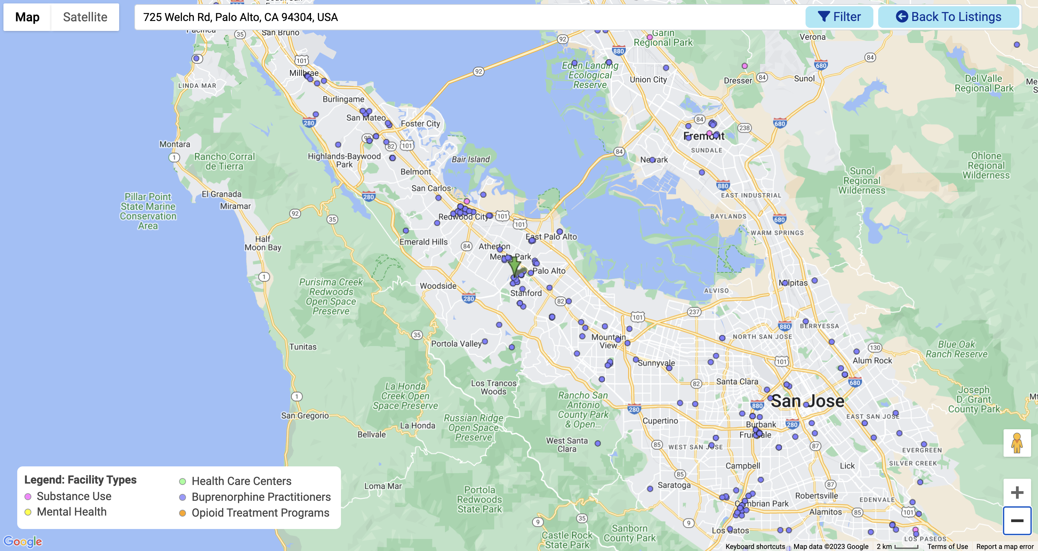
Know Where to Refer
https://findtreatment.samhsa.gov. Accessed 2023. Available at: https://findtreatment.gov

Slide 33
What We All Can Do:
1
Screen for substance use and refer for treatment
2
Discuss overdose prevention and harm reduction
3
Change the language of addiction to reduce stigma

Slide 34
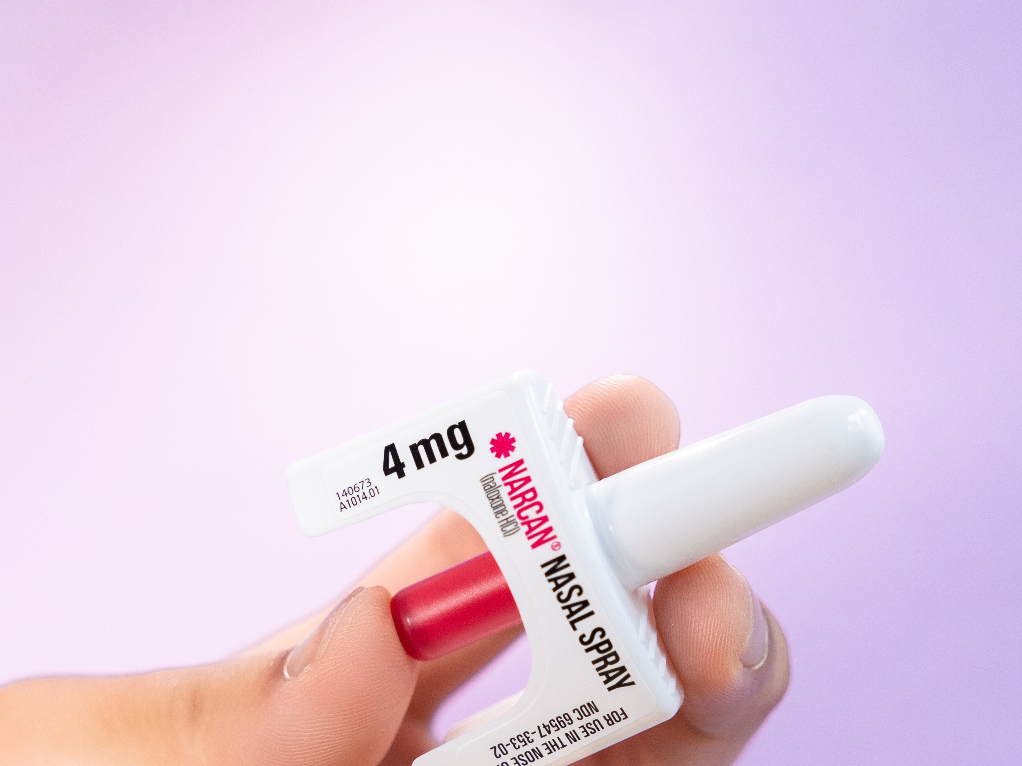
Overdose Prevention:
Be aware of counterfeit pills, heroin
Don’t use alone
Start with a little to assess effect
Avoid polysubstance use (especially with benzodiazepines)
Call 911 in event of overdose
Carry naloxone!
Harm Reduction:
Even when youth aren’t ready or able to stop substance use, we can offer:
  HIV testing and PrEP
  HCV testing and treatment
  Syringe exchange, education on safe injection
Services keep youth safe and build trust with you as a clinician
Robinson CA, Wilson JD. Pediatrics. 2020;145(Suppl 2):S153-S164

Slide 35
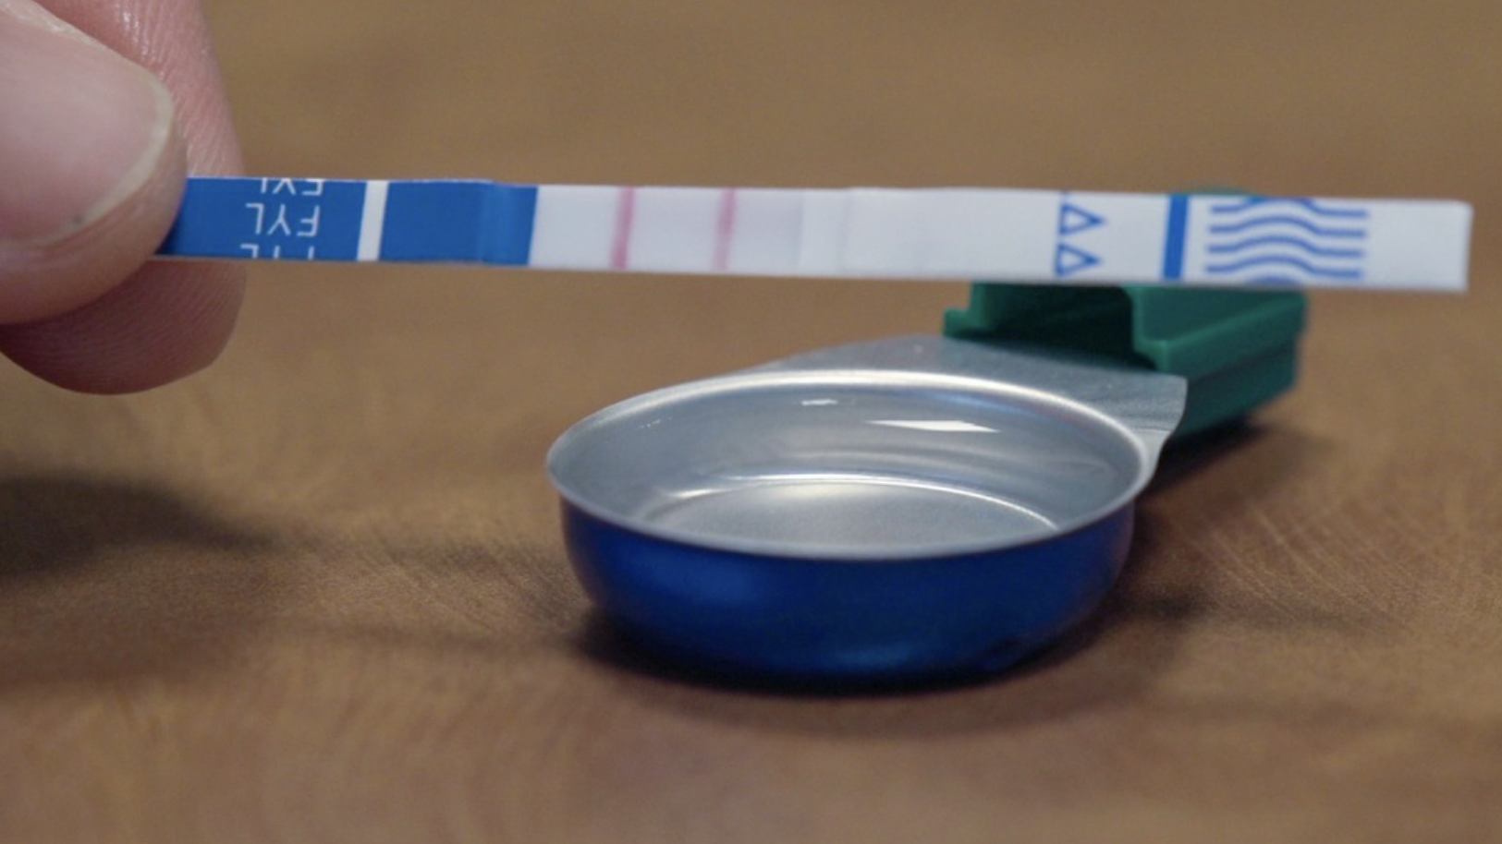
Fentanyl Test Strips
Add small amount of drug to clean, dry container
Add ½ tsp of water & mix
Dip waxy end for 15 sec
Remove, place on a flat surface for 2 min
Photo: Photo: Stephen Crocker/Brown University
JE Goldman, et al. Harm Reduct J. 2019; 8;16(1):3
US CDC, 2022. Available at: https://www.cdc.gov/stopoverdose/fentanyl/fentanyl-test-strips.html

Slide 36
What We All Can Do:
1
Screen for substance use and refer for treatment
2
Discuss overdose prevention and harm reduction
3
Change the language of addiction to reduce stigma

Slide 37
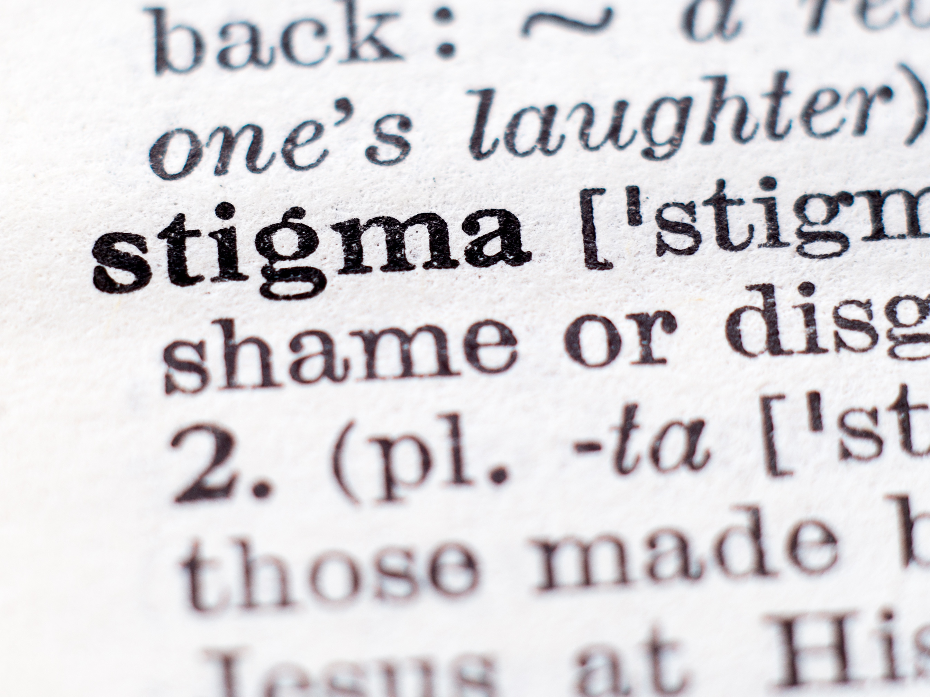
Problematic Terms | Preferable Terms
“Junkie” | “Person with substance use disorder”
“Druggie” | “Person with substance use disorder”
“Addict” | “Person with substance use disorder”
“Substance abuser” | “Person with substance use disorder”
“Substance abuse” | “Substance use”, “substance misuse”
“Clean” | “In recovery”
“Replacement therapy” | “Treatment” (buprenorphine)
“Born addicted” | “Born substance-exposed”
Committee on Substance Use and Prevention. Pediatrics. 2022;149(6):e2022057529

Slide 38
What We All Can Do:
1
Screen for substance use and refer for treatment
2
Discuss overdose prevention and harm reduction
3
Change the language of addiction to reduce stigma

Slide 39
Thank You!
Email: shadland@mgh.harvard.edu
Twitter: @DrScottHadland
Instagram: @drscotthadland
LinkedIn: scotthadland

